Slide 1
Capstone Project 3
Credit Card Default Prediction
Kiran Ahire

Slide 2
Points for Discussion
Business Objective
Data Summary
Feature Summary
Data Preprocessing
Exploratory Data Analysis
Corelation between data
Algorithms implementation
Conclusion

Slide 3
Business Objective
We are all aware what is Credit card. It is type of payment card in which charges are made against a line of credit instead of the account holder's cash deposits. When someone uses a credit card to make a purchase, that person's account accrues a balance that must be paid off each month.
Credit card default happens when you have become severely delinquent on your credit card payments. Missing credit card payments once or twice does not count as a default. A payment default occurs when you fail to pay the Minimum Amount Due on the credit card for a few consecutive months.
The provided dataset contains information about Gender, Amount of given credit, Education, Age, Repayment Status, Amount of Bill Statement, Amount of previous payment and the target is Default payment next month. This project is aimed at predicting the case of customers default payments in Taiwan.
ly of rental bikes.

Slide 4
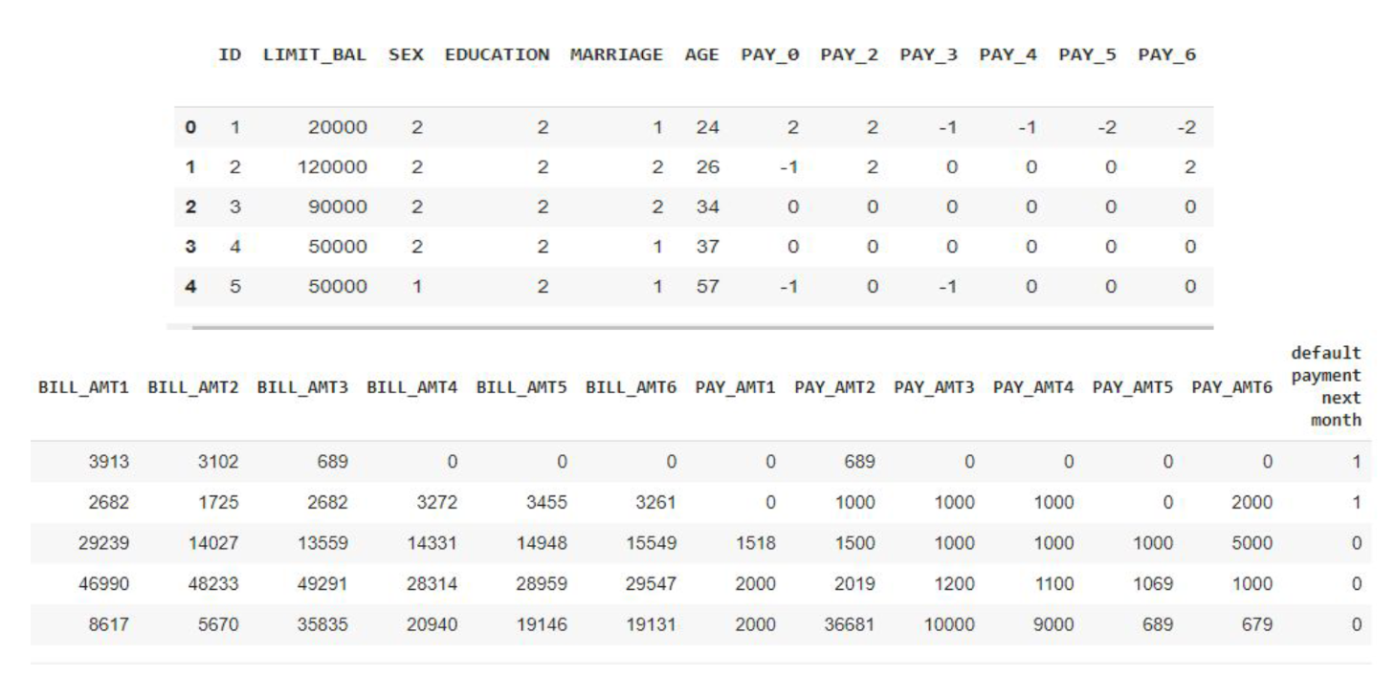
Data Summary

Slide 5
Feature Summary
X1 - Amount of the given credit
X2 - Gender
X3 - Education
X4 - Marital status
X5 - Age
X6 - X11: History of past payment from April to September
X12-X17: Amount of bill statement April to September
X18-X23: Amount of previous payment April to September
Y – Default payment

Slide 6
Data Preprocessing
The dataset contains 30000 rows and 25 columns
There are no missing values present
There are no duplicate values present
There are no null values present
‘Default payment next month’ is the dependent variable which we need to predict for our new observations
There 9 categorical variables in our dataset
I rename some of the features for convenience.

Slide 7
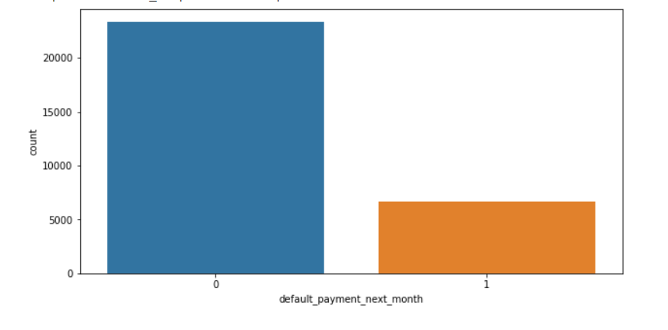
Analysis of Dependent variable
In our dataset ‘default payment next month’ is dependent variable.
From the above data analysis we can say that
0 - Not Default
1 - Default
Numbers of Defaulters are less than the Non Defaulters in the given dataset
From the graph we can see that both classes are not in proportion i.e imbalanced dataset so we normalize our dataset.
Notes:
A dependent variable is a variable whose value will change depending on the value of another variable. In out dataset, Our dependent variable is "default_payment_next_month“
In this if Y=0 then not default, Y=1 then default".

Slide 8
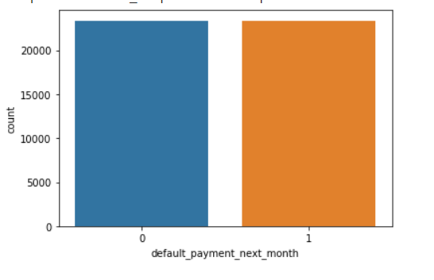
SMOTE
SMOTE - Synthetic Minority Oversampling Technique is Oversampling is one of the most commonly used oversampling methods to solve the imbalance problem. It aims to balance class distribution by randomly increasing minority class examples by replicating them.
After performing SMOTE we get this balanced dataset.

Slide 9
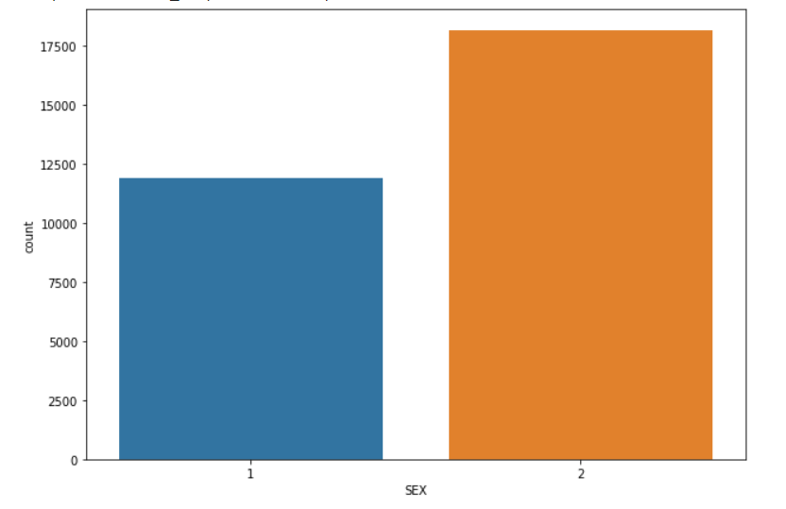
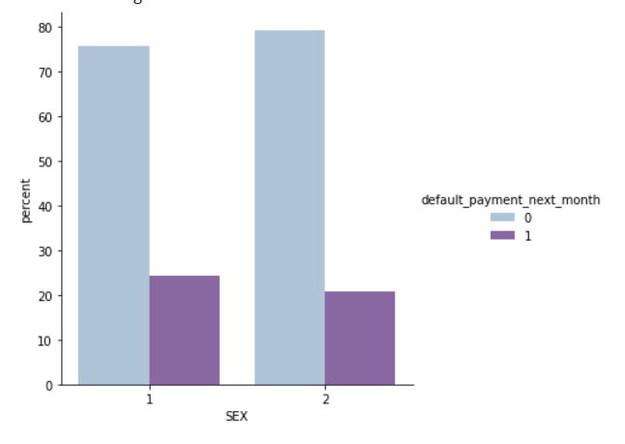
Analysis of SEX
From the above data analysis we can say that
1 - Male
2 - Female
Number of Male credit holder is less than Female.
From the above graph we can say that number of defaulter have high
proportion of Males.

Slide 10
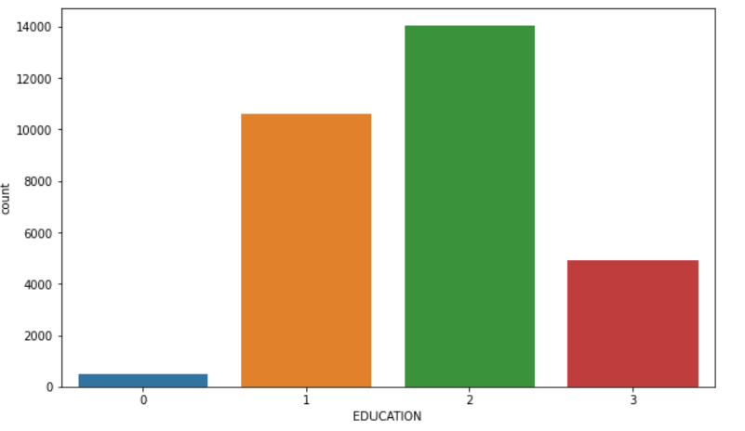
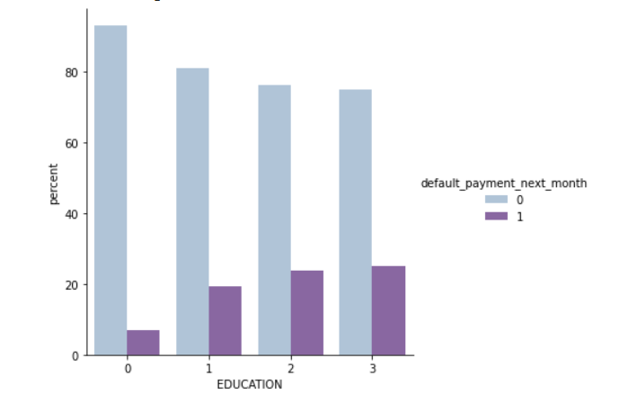
Analysis of Education
1 = graduate school; 2 = university; 3 = high school; 0 = others
From the above data analysis we can say that
More number of credit holders are university students followed by Graduates and then High school students.
From the above plot it is clear that people in Other category have higher default payment as compared to graduates and university people

Slide 11
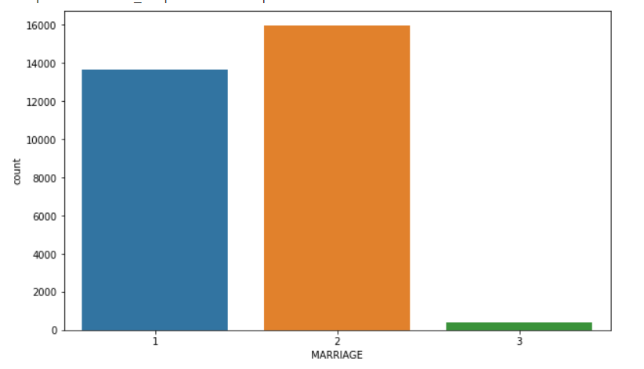
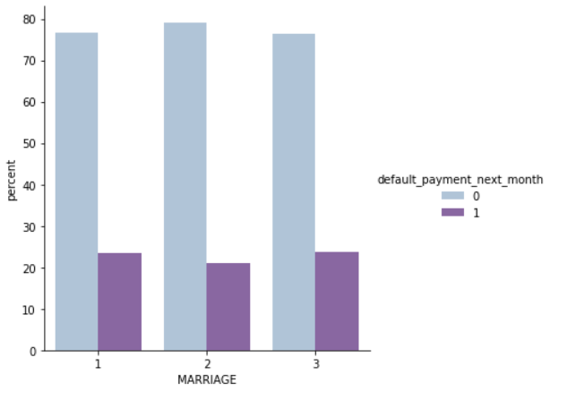
Analysis of Marriage
1 = married; 2 = single; 3 = others
From the above data analysis we can say that
1 - married
2 - single
3 - others
More number of credit cards holder are Single.
from the above graph we can say that defaulter rate of Married and others category more than those of single.

Slide 12
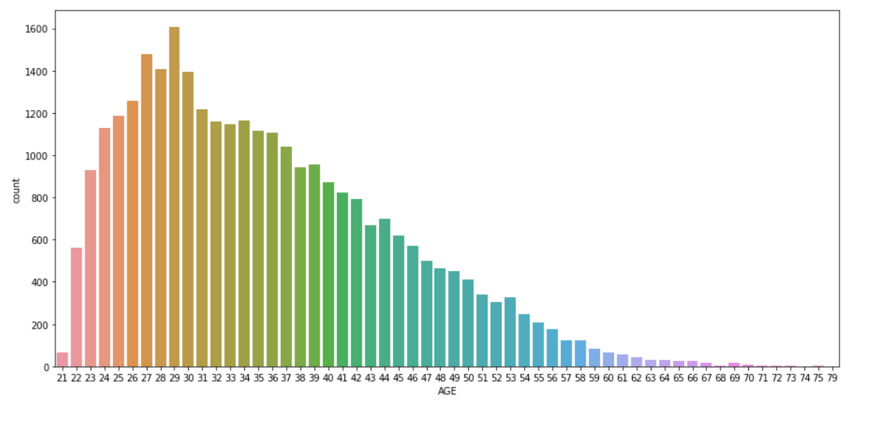
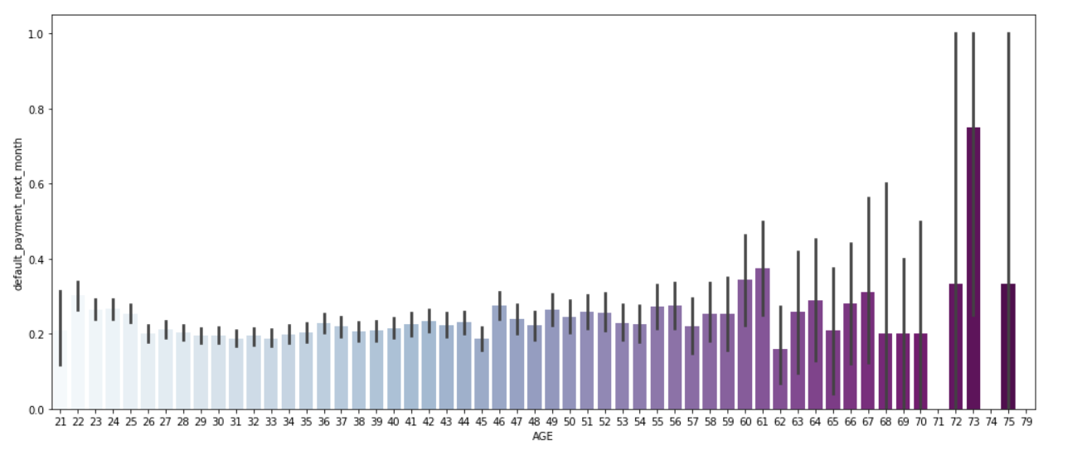
Analysis of Age
From the above data analysis we can say that
We can see more number of credit cards holder age are between 26-30 years old.
Age above 60 years old rarely uses the credit card.
default rate is higher in people whose age is more than 60.

Slide 13
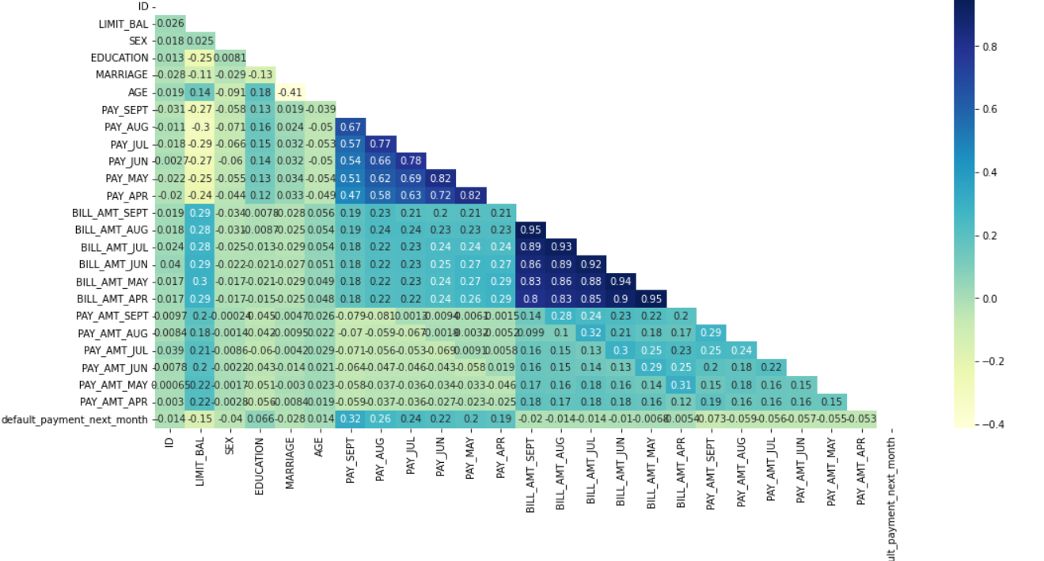
Corelation between variables

Slide 14
One Hot Encoding
Many machine learning algorithms cannot work with categorical data directly. The categories must be converted into numbers. This is required for both input and output variables that are categorical.
One hot encoding is one method of converting data to prepare it for an algorithm and get a better prediction.
With one-hot, we convert each categorical value into a new categorical column and assign a binary value of 1 or 0 to those columns. Each integer value is represented as a binary vector.
Here we performed One Hot Encoding on ‘EDUCATION’ , ‘MARRIAGE’ , ‘PAY_SEPT’,
‘PAY_AUG’, ‘PAY_JULY’, ‘PAY_JUNE’, ‘PAY_MAY’
We have applied Label encoding on feature ‘SEX’

Slide 15
Models Implemented
1 . Logistic Regression
2. Random Forest

Slide 16
Logistic Regression
Logistic Regression - Logistic Regression is actually a classification algorithm that was given the name regression due to the fact that the mathematical formulation is very similar to linear regression.
The function used in Logistic Regression is sigmoid function or the logistic function given by:
f(x)= 1/1+e ^(-x)
Our best parameters from listed hyperparameters are :
{'C': 0.1, 'penalty': 'l2’}
From the regression model we get the following results
The accuracy on test data is 0.751377991051164
The precision on test data is 0.6883268482490272
The recall on test data is 0.7876224398931434
The f1 on test data is 0.7346345514950168
The roc_score on test data is 0.755437386018206

Slide 17
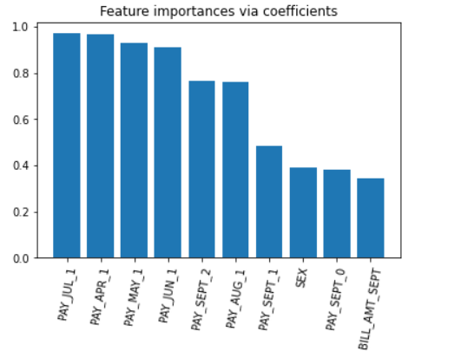
Feature Importance
From the above feature importance graph we can say that the most important feature that make an impact on dependent variable are PAY_JUL_1,PAY_MAY_1,PAY_APR_1

Slide 18
Random Forest
Random Forest Classifier - Random Forest is a bagging type of Decision Tree Algorithm that creates a number of decision trees from a randomly selected subset of the training set, collects the labels from these subsets and then averages the final prediction depending on the most number of times a label has been predicted out of all.
Our best parameters from listed hyperparameters are :
{'max_depth': 30, 'n_estimators': 200}
From the model we get the following results
The accuracy on test data is 0.8333441411062836
The precision on test data is 0.8007782101167316
The recall on test data is 0.8565482796892342
The f1 on test data is 0.8277248960986728
The roc_score on test data is 0.8347638512777109

Slide 19
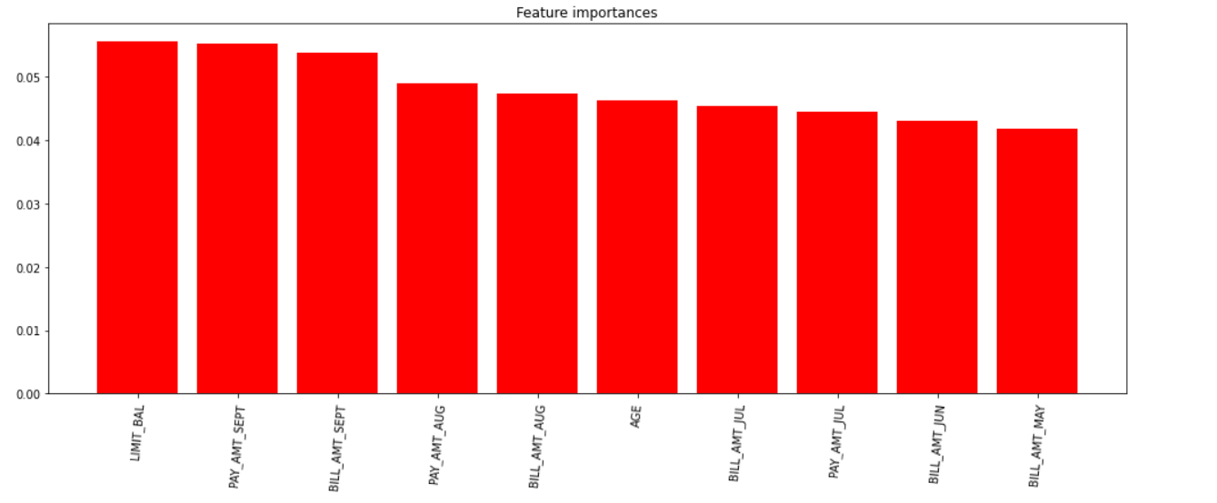
Feature Importance
from the above feature importance graph we can say that the most important feature are LIMIT_BAL,PAY_AMT_SEPT

Slide 20
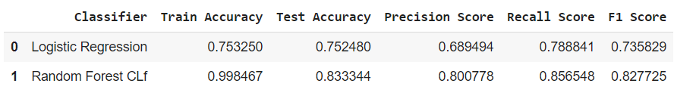
Evaluating the model
We implemented 2 algorithms Logistic Regression, Random Forest Classifier. The results of our evaluation are:

Slide 21
Conclusion
Recent two month payment status and credit limit are strongest default predictor.
From above table we can see that Logistic Regression having Recall, F1-score equals 78%, 73% resp and Random forest Classifier having Recall, F1-score values equals 85%, 83%resp.
The best accuracy is obtained for the Random forest than Logistic Regression.
If the balance of recall and precision is the most important metric, then Random Forest is the ideal model. Since Random Forest has slightly lower recall but much higher precision than Logistic Regression, I would recommend Random Forest.

